Slide 1
Module-3: FUNCTIONS AND POINTERS :
Modular programming : Function prototype, function definition, function call, Built-in functions (string functions, math functions) Recursion, Binary Search using recursive functions.
Pointers: Pointer operators, Pointer arithmetic, Arrays and pointers, Array of pointers.
Parameter passing: Pass by value, Pass by reference.

Slide 2
Modular Programming:
Modular programming is a software design technique that emphasizes breaking down a program into smaller, self-contained, and reusable modules.
Each module is responsible for a specific functionality and can be independently developed, tested, and maintained.

Slide 3
Key Concepts of Modular Programming:
Modularity: The program is divided into separate modules, each handling a specific part of the functionality.
Encapsulation: Each module hides its internal implementation and exposes only the necessary functions or data.
Reusability: Modules can be reused in different parts of a program or even in different programs.
Maintainability: Since modules are independent, debugging and modifying the code becomes easier.
Scalability: New features can be added without affecting existing modules significantly.

Slide 4
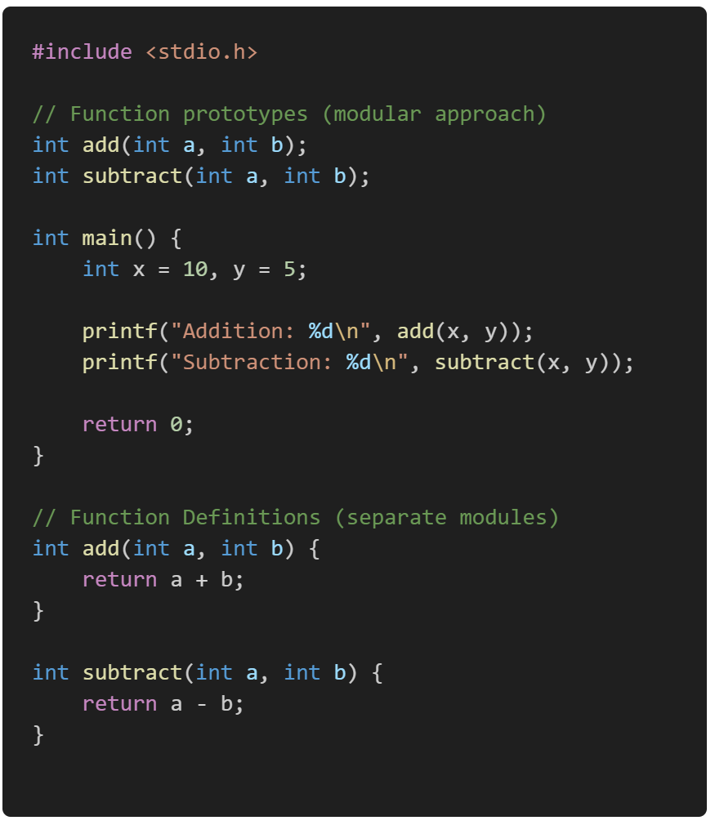
Example:
Advantages of Modular Programming
Improved Code Organization – Easier to understand and navigate.
Faster Development – Different developers can work on different modules simultaneously.
Easier Debugging & Testing – Each module can be tested independently.
Code Reusability – Modules can be used in multiple programs.

Slide 5
Function Prototype (Declaration):
A function prototype in C is a declaration of a function that specifies the function's name, return type, and parameters (with their types) before the actual function definition.
It serves as a forward declaration that informs the compiler about the function's signature before it is used.
Syntax:
return_type: The data type of the value the function returns.
function_name: The name of the function.
type1, type2, ...: The data types of the parameters the function takes.

Slide 6
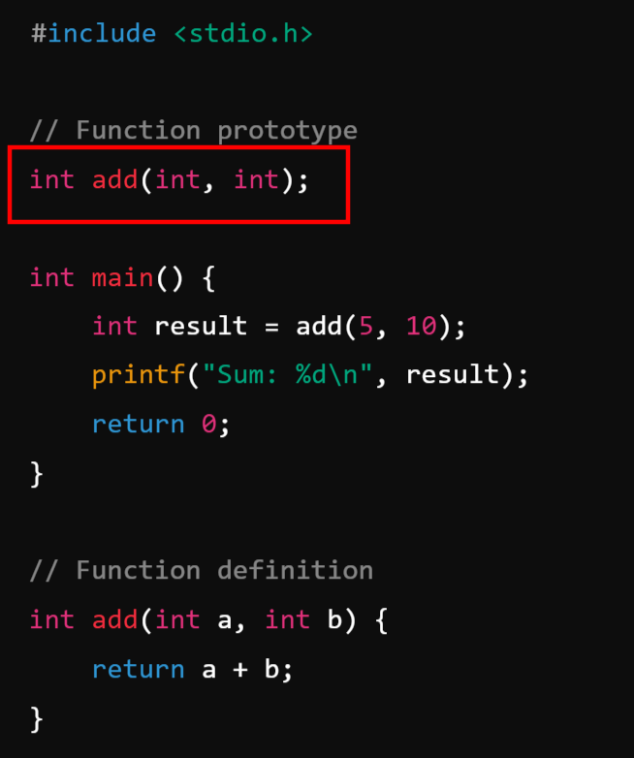
Example:
The function prototype int add(int, int); tells the compiler that a function named add exists, which takes two integers and returns an integer.
The function is used in main() before its definition.
The actual function definition appears later in the program.

Slide 7
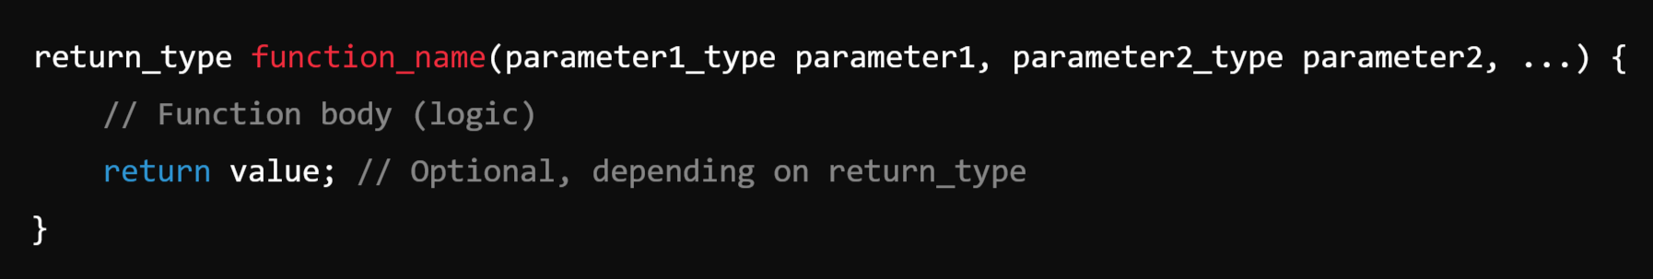
Function Definition in C:
A function definition in C specifies the actual implementation of a function. It provides the function's body, which contains the logic to execute when the function is called.
Syntax:
function body: Contains the code that runs when the function is called.
return statement: Sends back a value if the function is not void.

Slide 8
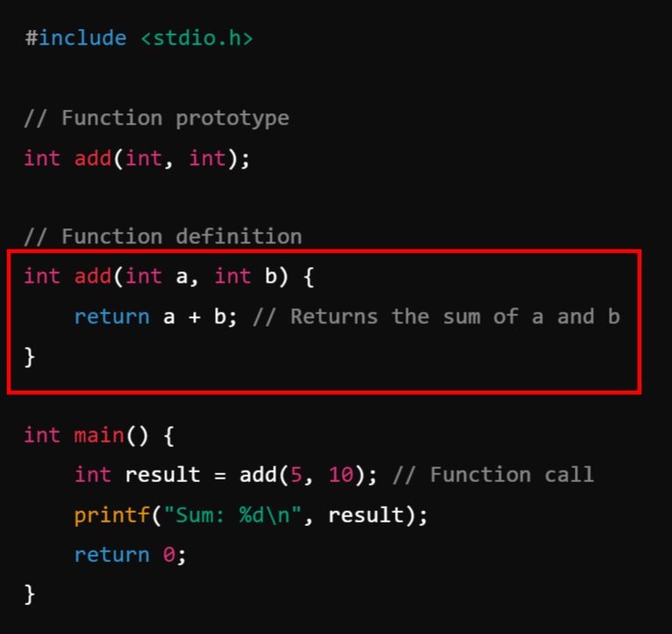
Example:
The function add is defined as int add(int a, int b).
The function takes two integers as parameters and returns an integer (int).
Inside the function, a + b is computed and returned.
The function is called in main(), and its result is stored in result.

Slide 9
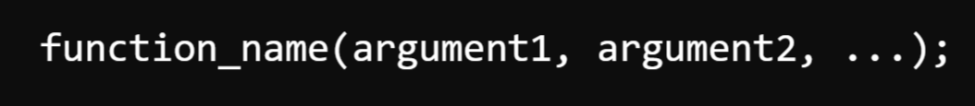
Function Call:
A function call in C is the process of executing a function by invoking its name and passing required arguments. The function is executed when it is called, and it returns a value if it has a return type.
Syntax:
function_name: The name of the function being called.
arguments: Values passed to the function (if required).
If the function returns a value, the return value can be stored in a variable.

Slide 10
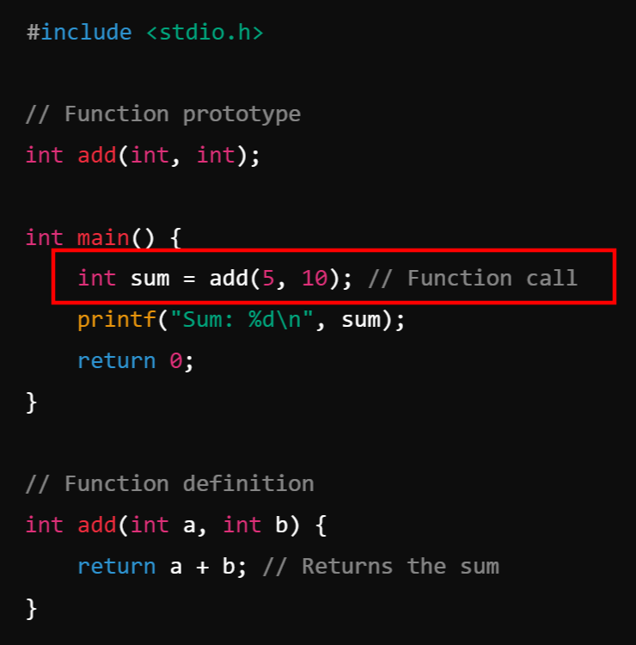
Example:
Function Prototype: int add(int, int); declares the function.
Function Call: add(5, 10); calls the function and passes 5 and 10 as arguments.
Function Definition: add(int a, int b) executes, adding the two numbers and returning the result.
Return Value: The result is stored in sum and printed.

Slide 11
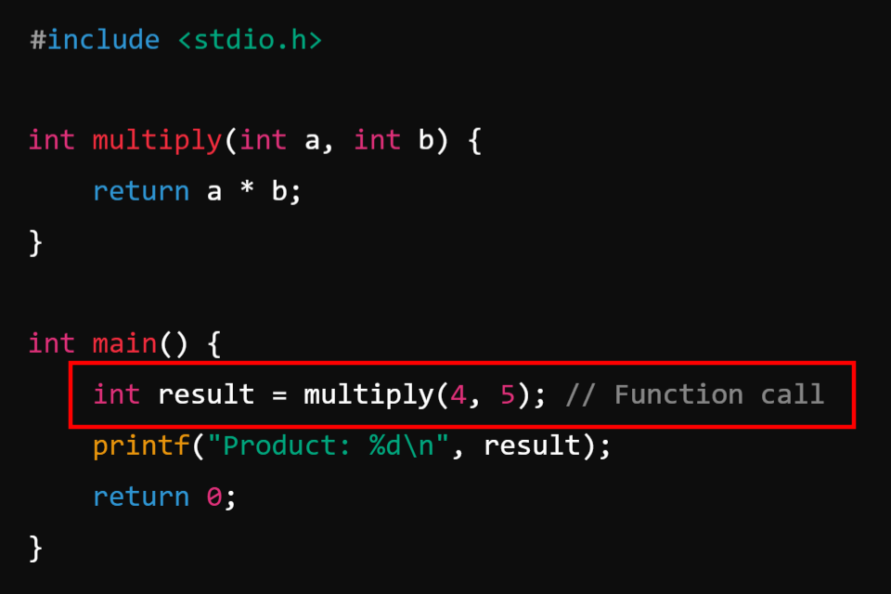
Types of Function Calls:
1. Function Call with Arguments & Return Value:

Slide 12
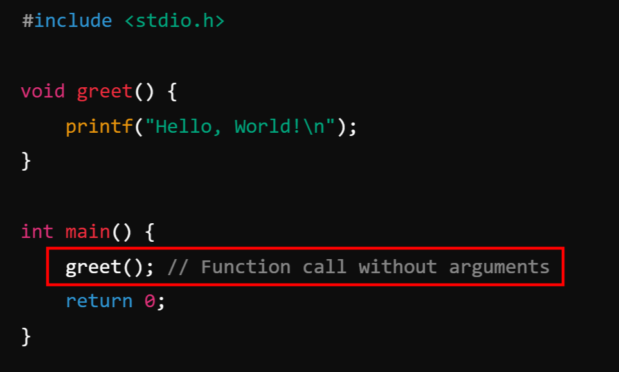
2. Function Call Without Arguments & Without Return Value:

Slide 13
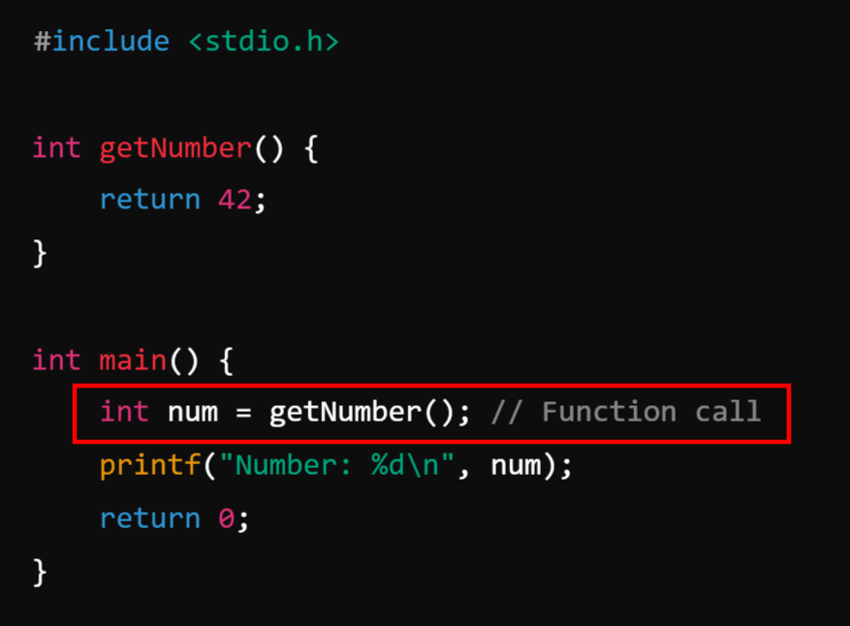
3. Function Call Without Arguments & With Return Value:

Slide 14
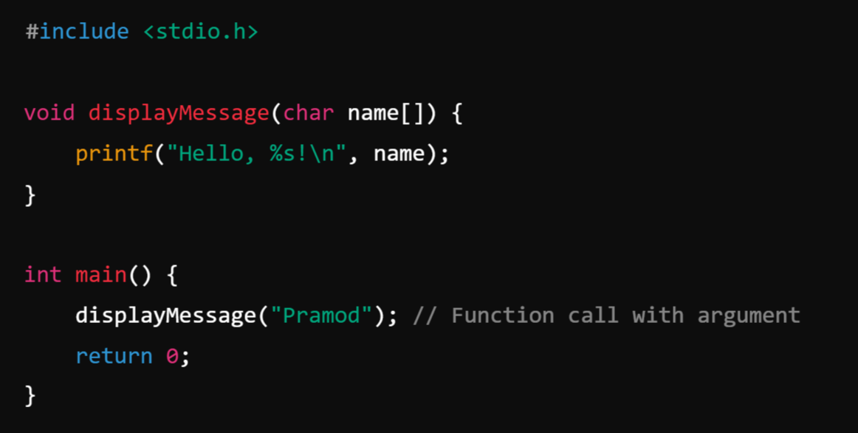
4. Function Call With Arguments & Without Return Value:

Slide 15
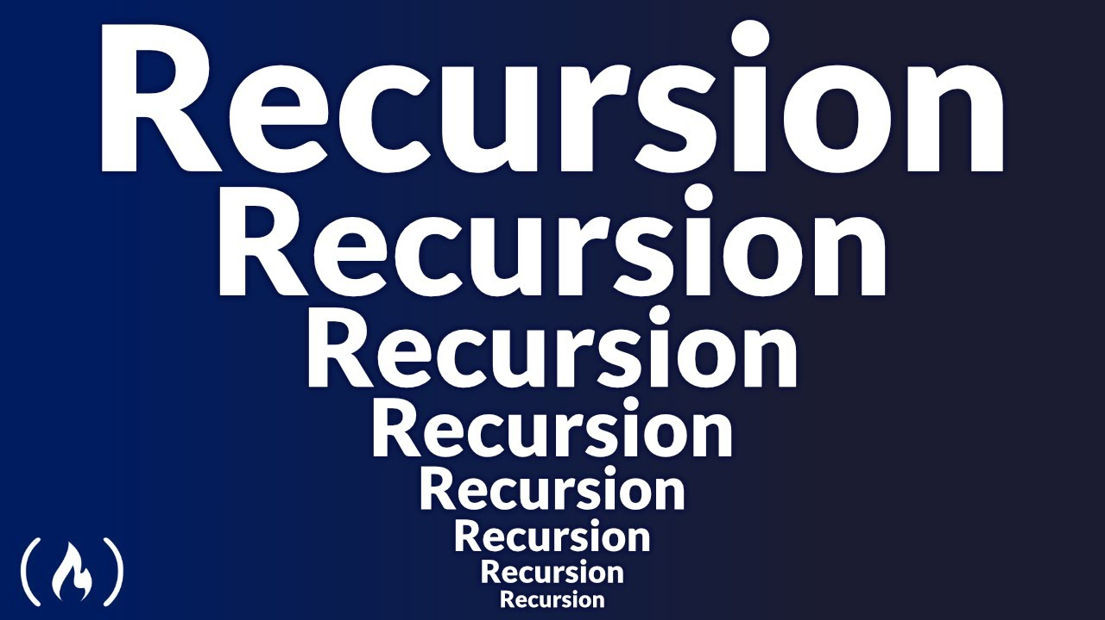


Slide 16
What is Recursion?
Recursion is a programming technique where a function calls itself to solve smaller instances of the same problem. The function continues calling itself until it reaches a base case, which stops further recursion.
When a function calls by itself again and again until and unless a base or exit condition is satisfied.

Slide 17
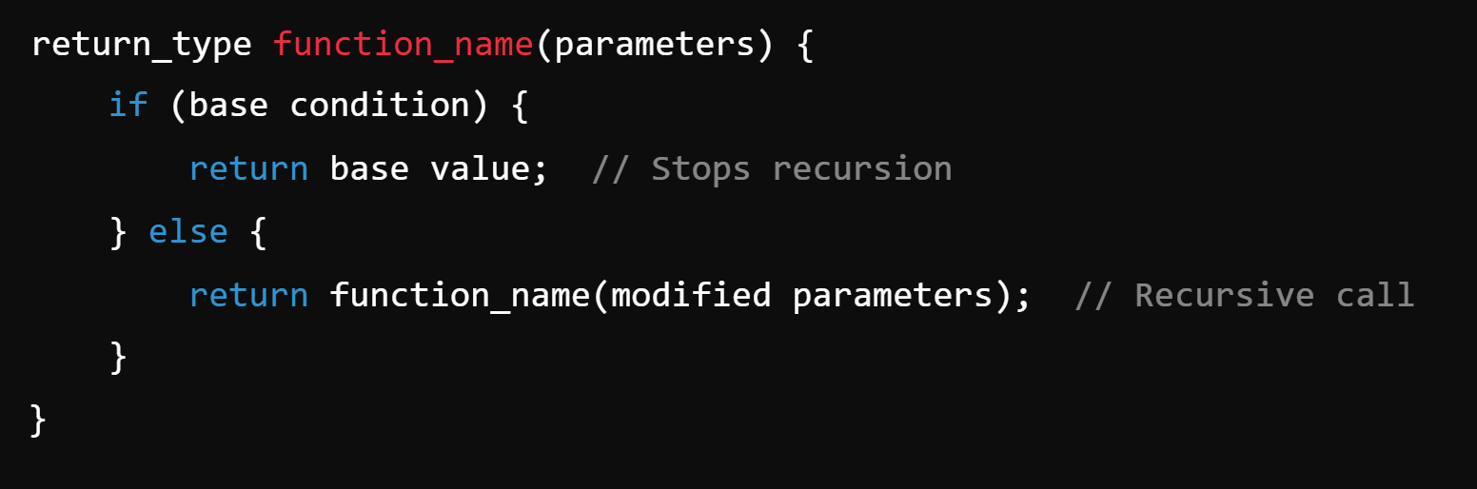
Syntax:

Slide 18
How Recursion Works?
Recursive Case: The function calls itself with modified parameters.
Base Case: A condition that stops the recursion to prevent infinite loops.
Stack Memory Usage: Each recursive call is stored in the call stack, and execution returns when the base case is reached.

Slide 19
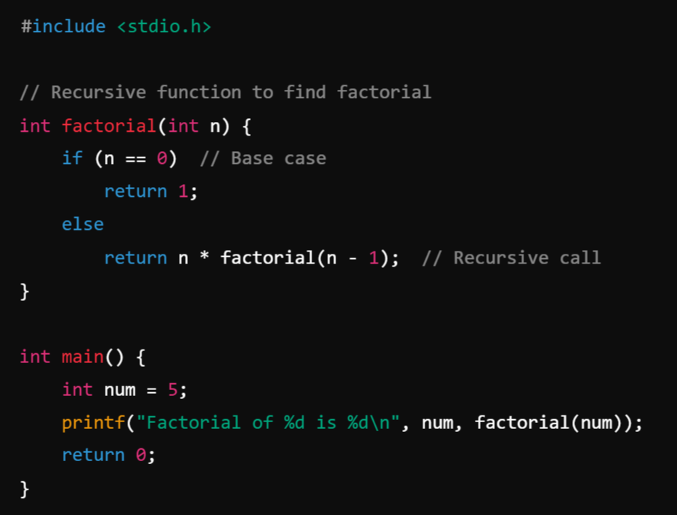
Example 1: Factorial Using Recursion: The factorial of a number n is n * (n-1) * (n-2) * ... * 1.

Slide 20
Example 1: Factorial Using Recursion: The factorial of a number n is n * (n-1) * (n-2) * ... * 1.

Slide 21
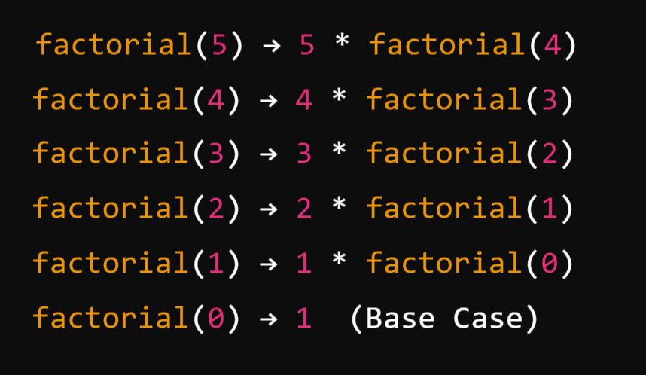
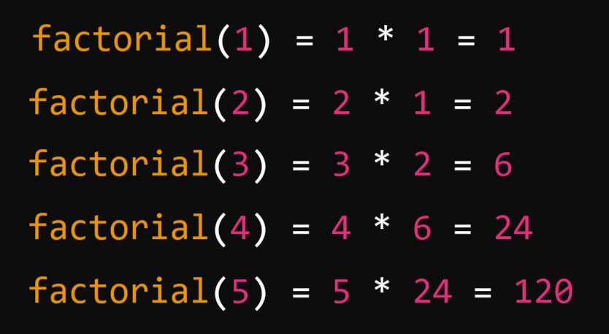
Execution Steps for factorial(5)
Returns

Slide 22
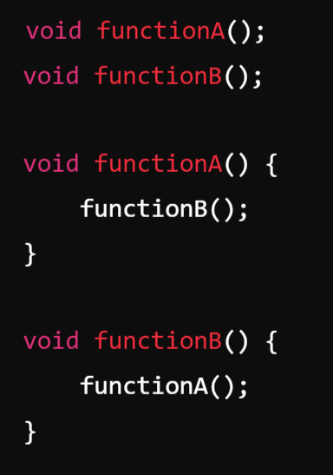
Types of Recursion:
Direct Recursion: A function directly calls itself.
Indirect Recursion: A function calls another function, which in turn calls the first function.
Example:

Slide 23
Advantages of Recursion:
Simplifies Complex Problems: Recursion provides a cleaner and more intuitive approach to problems like tree traversal, factorial, Fibonacci, etc.
Reduces Code Size: Eliminates the need for loops in certain cases.
Useful in Data Structures: Helps in recursion-heavy operations like traversing trees, graphs, and sorting algorithms (e.g., QuickSort, MergeSort).
Disadvantages of Recursion:
High Memory Usage: Each recursive call adds a new frame to the stack, leading to stack overflow if not handled properly.
Performance Issues: Recursive functions can be slower than iterative solutions due to repeated function calls.
Difficult to Debug: Understanding the flow of recursion can be tricky.

Slide 24
Binary Search using recursive functions

Slide 25
Binary Search:
Binary Search is an efficient algorithm for finding the position of a target element (key) in a sorted array. It works by repeatedly dividing the search interval in half until the target is found or the interval becomes empty.
Characteristics of Binary Search:
Works only on sorted data.
Time Complexity:
Best Case: O(1) (if the middle element is the target).
Worst Case: O(log⁡n) (halving the search interval each step).
Average Case: O(log⁡n).
Space Complexity:
Iterative version: O(1)
Recursive version: O(log⁡n) (due to recursion stack).

Slide 26
How Binary Search Works:
Start with the entire array as the search interval.
Find the middle element of the current interval.
Compare the middle element with the target:
If the middle element is equal to the target, return its index.
If the target is smaller, search in the left half of the interval.
If the target is larger, search in the right half of the interval.
Repeat steps 2 and 3 until the target is found or the interval becomes empty (i.e., the low index exceeds the high index).

Slide 27
Algorithm
Iterative Version
Initialize low to 0 and high to n−1 (array bounds).
While low is less than or equal to high:
Compute the middle index: mid=low+(high−low)/2
If arr[mid] == key, return mid.
If arr[mid] > key, search in the left half (high=mid−1).
If arr[mid] < key, search in the right half (low=mid+1).
If the interval becomes empty, return -1 (target not found).

Slide 28
Recursive Version
Base Case:
If low>high, return -1.
Compute the middle index: mid=low+(high−low)/2.
If arr[mid]==key, return mid.
Recursive Steps:
If arr[mid]>key, search in the left half.
If arr[mid]<key, search in the right half.

Slide 29
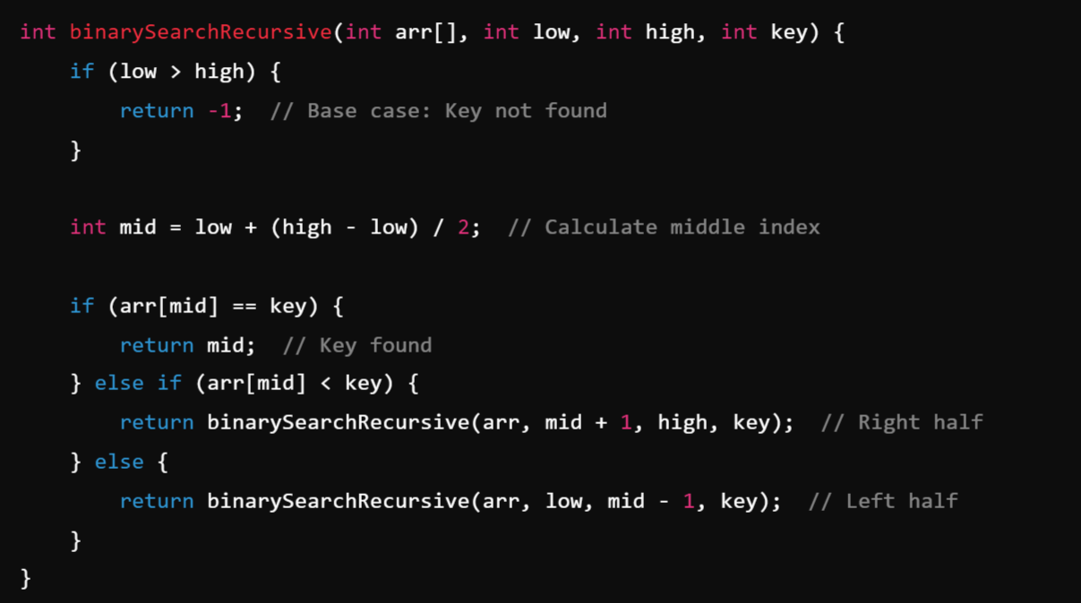
Recursive Implementation:

Slide 30
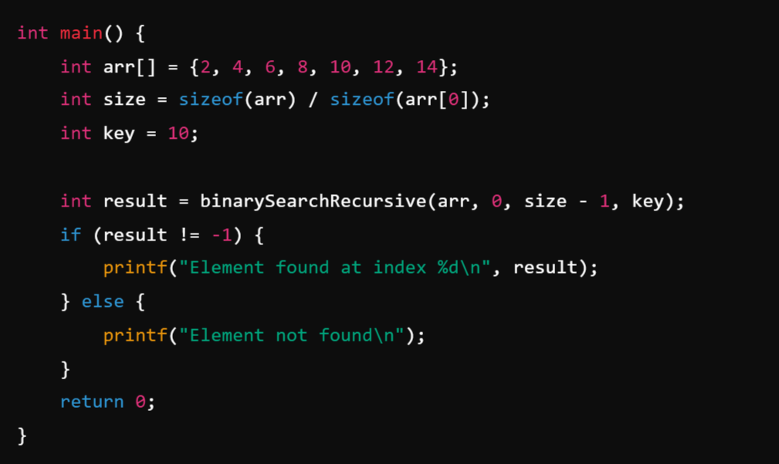
Main Method:

Slide 31
Pointers

Slide 32
Pointers:
A pointer in C is a variable that stores the memory address of another variable. Instead of holding an actual value, a pointer holds the location where the value is stored.
Declaration of a Pointer: To declare a pointer, use the * operator:
Here, ptr is a pointer to an integer.

Slide 33
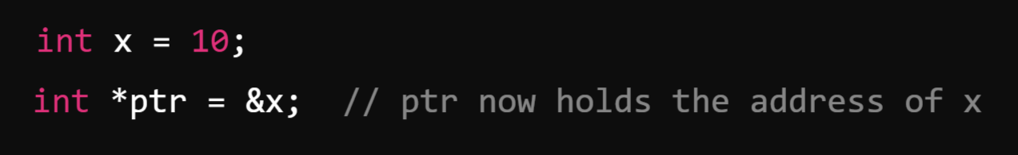
2. Initializing a Pointer: A pointer is initialized using the address-of (&) operator:
&x gives the memory address of x
ptr stores this address

Slide 34
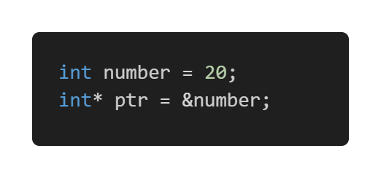
Example:
aaa3
fff4
fff4
20
ptr
number
(Pointer)
(Normal Variable)

Slide 35
Dereferencing a Pointer: To access the value stored at the memory address, use the * (dereference) operator:
Here, *ptr fetches the value stored at the address held by ptr.

Slide 36
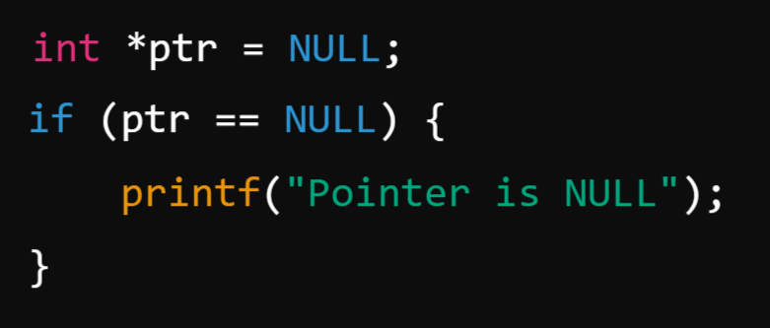
NULL Pointers: A NULL pointer points to nothing and is often used for safety:

Slide 37
Pointer operators:
C provides several operators to work with pointers effectively.
The two fundamental pointer operators are:
1. Address-of Operator (&)
2. Dereference Operator (*)
Additionally, pointer arithmetic involves operators like:
3. Increment (++) and Decrement (--)
4. Addition (+) and Subtraction (-)
5. Comparison Operators (==, !=, <, >, etc.)

Slide 38
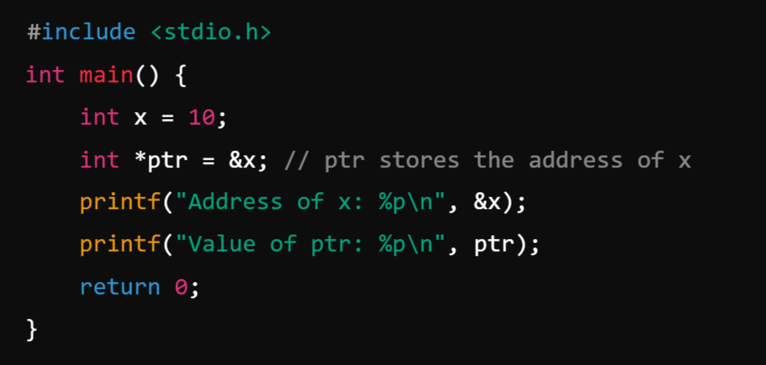
Address-of Operator (&):
The & operator is used to get the memory address of a variable.
Example:

Slide 39
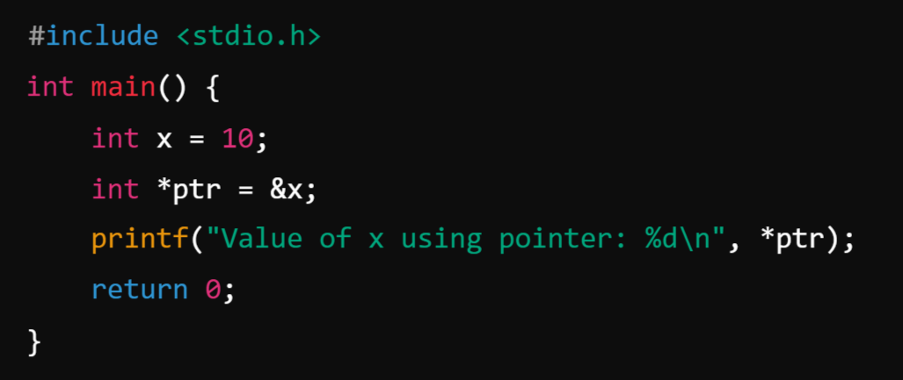
2. Dereference Operator (*):
The * operator is used to access the value stored at the memory address a pointer holds.
Example:

Slide 40
3. Pointer Arithmetic Operators:
Pointers support arithmetic operations like increment (++), decrement (--), addition (+), and subtraction (-).
Increment (++) and Decrement (--): These move the pointer to the next or previous memory location.

Slide 41
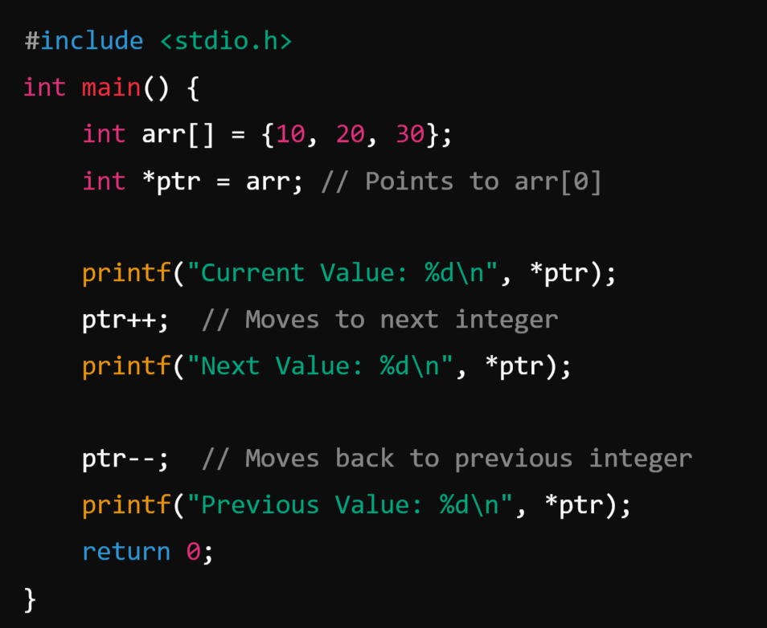
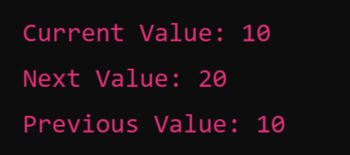
Example:
Output:
📝 Since int takes 4 bytes, ptr++ moves 4 bytes ahead in memory.

Slide 42
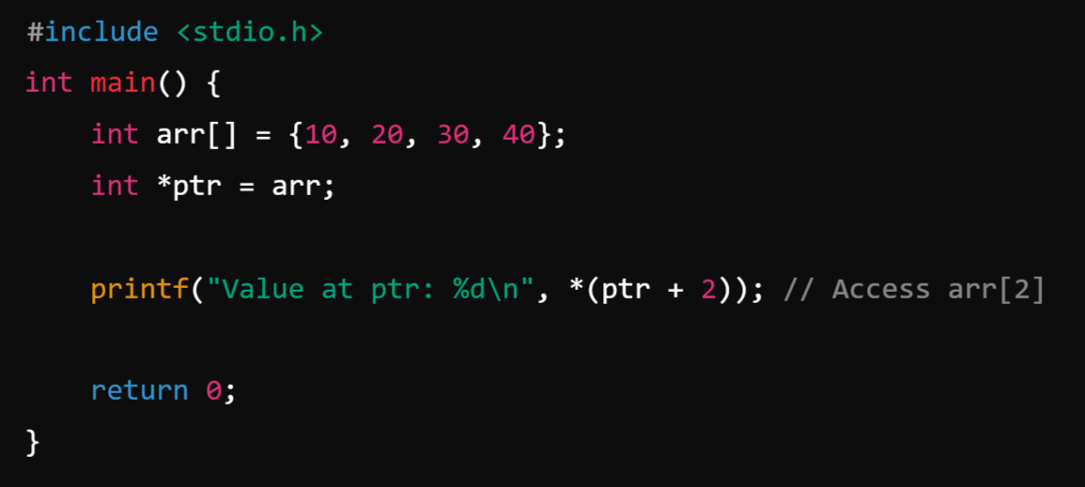
Addition (+) and Subtraction (-):

Slide 43
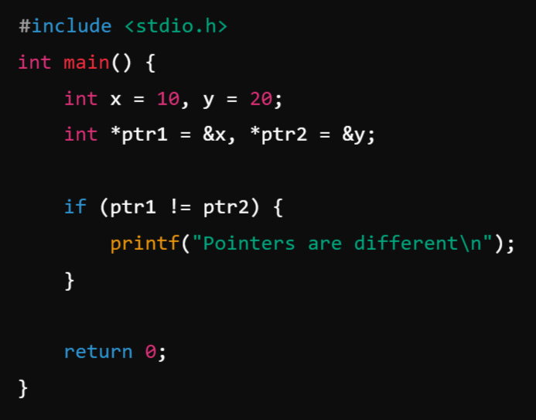
4. Pointer Comparison Operators (==, !=, <, > ):
Pointers can be compared to check if they point to the same location.
Example:

Slide 44
Pointer arithmetic:
Pointer arithmetic allows you to manipulate memory addresses in a structured way. Since pointers store memory addresses, we can perform arithmetic operations on them to navigate through memory.
In C, we can perform the following arithmetic operations on pointers:
Increment (++) – Moves the pointer to the next memory location.
Decrement (--) – Moves the pointer to the previous memory location.
Addition (+) – Moves the pointer forward by a specified number of elements.
Subtraction (-) – Moves the pointer backward by a specified number of elements.
Difference (ptr1 - ptr2) – Computes the number of elements between two pointers.
Comparison (==, !=, >, <) – Compares pointer addresses.

Slide 45
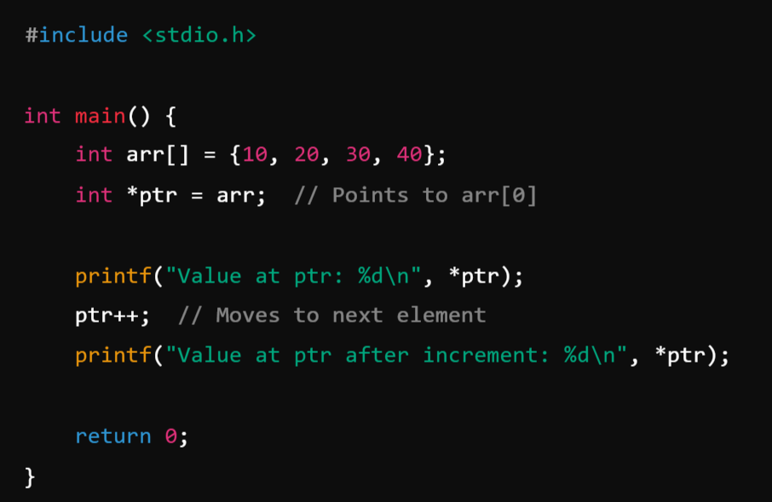
1️⃣ Pointer Increment (++):
When you increment a pointer, it moves to the next memory location based on data type size.
Example:

Slide 46
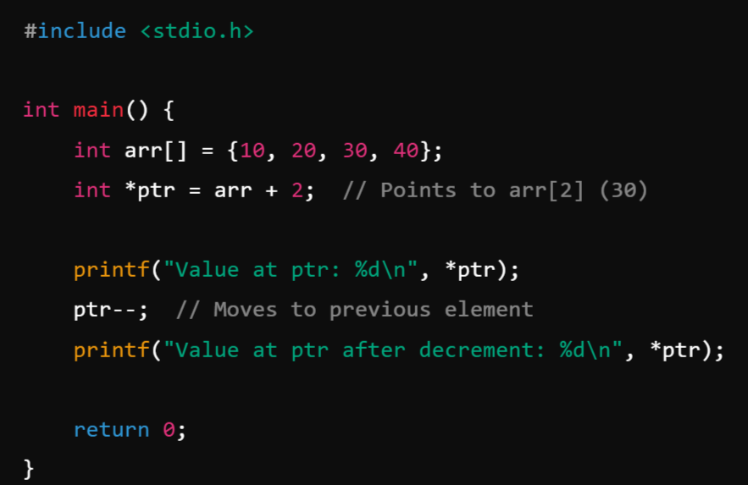
2️⃣ Pointer Decrement (--):
Example:

Slide 47
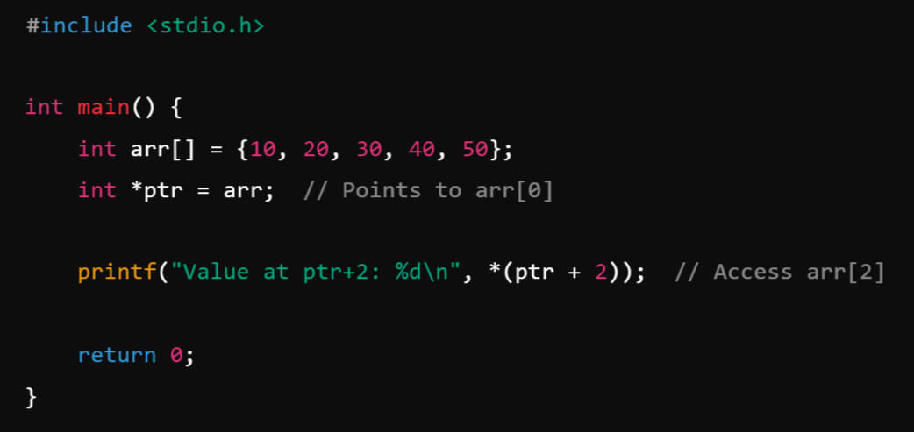
3️⃣ Pointer Addition (ptr + n): You can move a pointer forward by n positions.

Slide 48
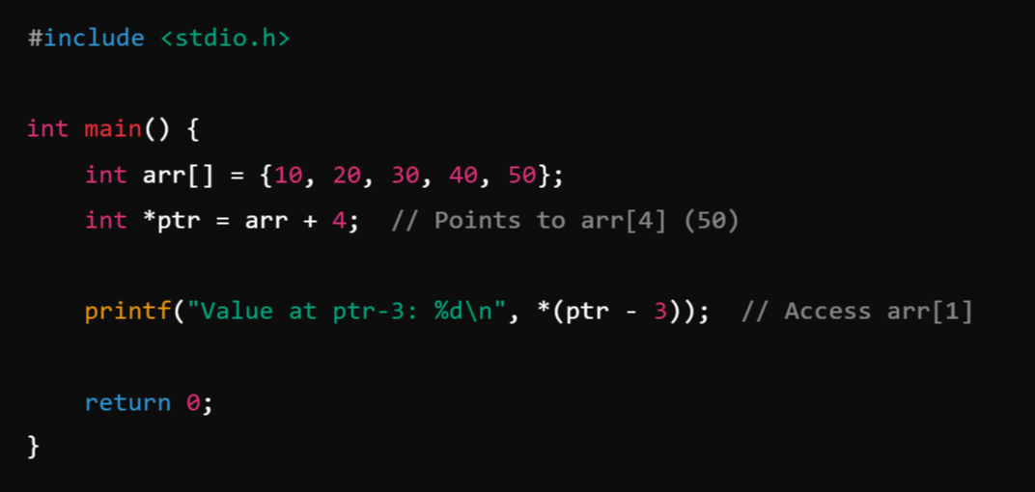
4️⃣ Pointer Subtraction (ptr - n):
Example:

Slide 49
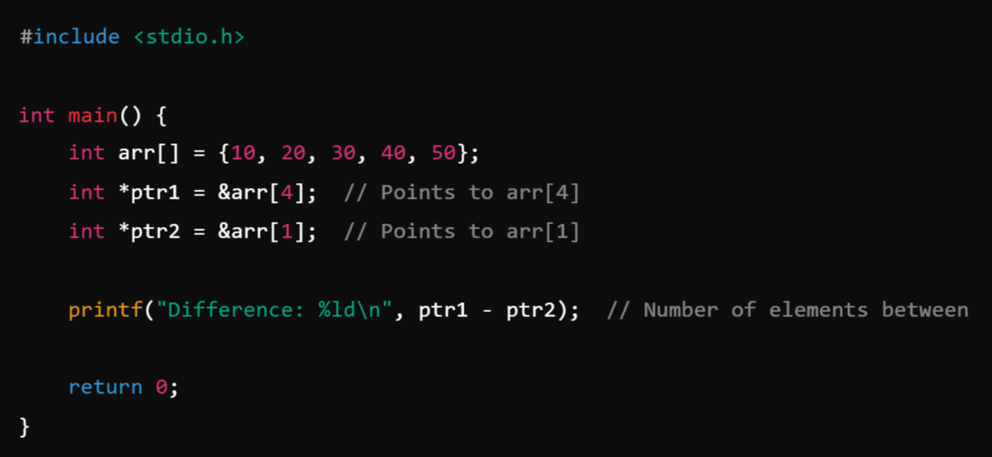
5️⃣ Pointer Difference (ptr1 - ptr2):
Pointer subtraction gives the number of elements between two pointers.

Slide 50
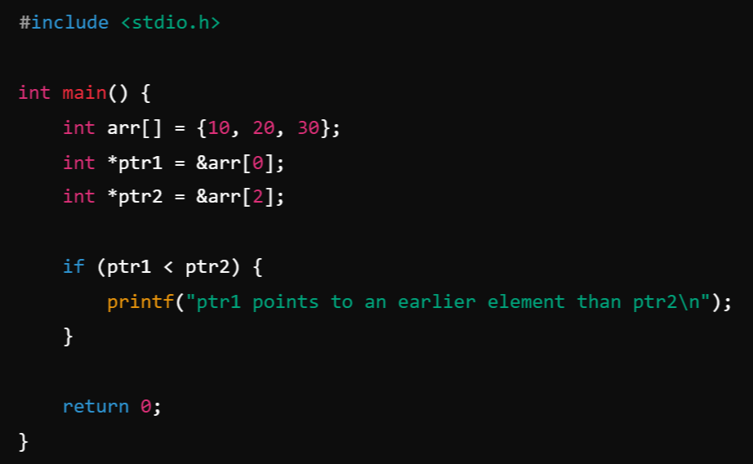
6️⃣ Pointer Comparison (==, !=, >, <):
Pointers can be compared to check their relative positions.

Slide 51
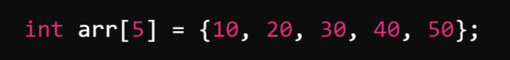
Arrays and Pointers:
In C, pointers and arrays are closely related. An array name acts as a pointer to the first element of the array, and pointers can be used to traverse and manipulate arrays efficiently.
1. Basics: How Arrays and Pointers are Related:
When you declare an array:
arr is the name of the array, but it is also a constant pointer to the first element (&arr[0]).
arr[i] is equivalent to *(arr + i), which uses pointer arithmetic.

Slide 52
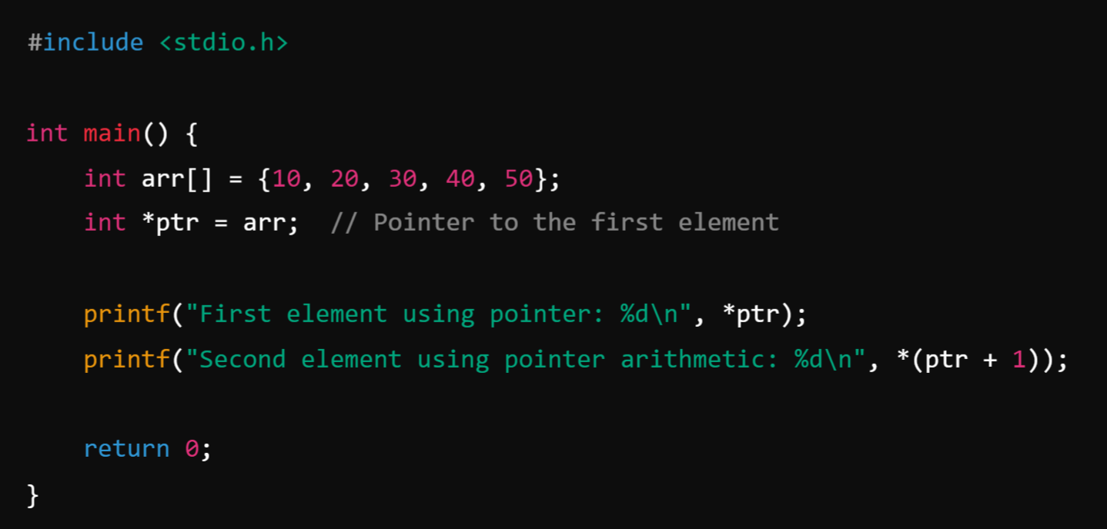
2. Accessing Array Elements Using Pointers:
You can use a pointer to iterate through an array.
Example: Using Pointers to Access Array Elements

Slide 53
Where,
ptr = arr; → ptr now stores the address of arr[0].
*ptr → Dereferences ptr, so *ptr = arr[0] = 10.
*(ptr + 1) → Moves to the next element (arr[1] = 20).

Slide 54
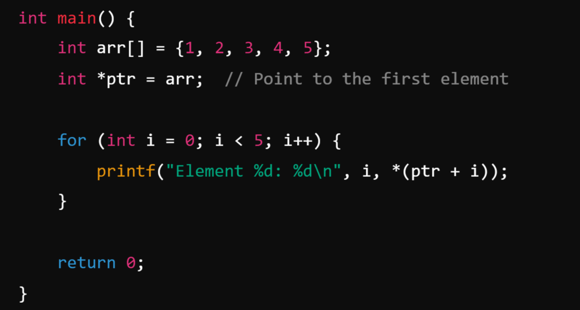
3. Iterating Through an Array Using a Pointer:
Instead of using array indexing (arr[i]), we can use a pointer to traverse the array.
Example: Using a Pointer to Iterate Over an Array
ptr + i moves the pointer i positions forward.
*(ptr + i) accesses the value at that position.

Slide 55
4. Pointer Arithmetic in Arrays:
Pointer arithmetic works because arrays are stored in contiguous memory locations.
Pointer Operations:
Operation | Meaning
ptr + 1 | Moves to the next element (sizeof(data type) bytes forward)
ptr - 1 | Moves to the previous element
ptr++ | Increments pointer (moves to next element)
ptr-- | Decrements pointer (moves to previous element)

Slide 56
5. Passing Arrays to Functions Using Pointers:
When you pass an array to a function, only the pointer to the first element is passed.
Example: Passing an Array to a Function

Slide 57
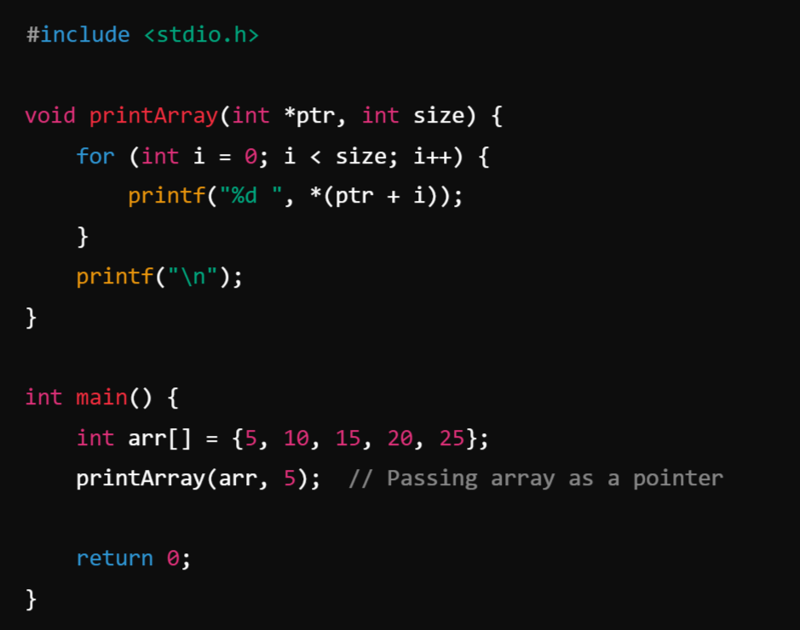
Example:
The function receives a pointer, not the entire array.

Slide 58
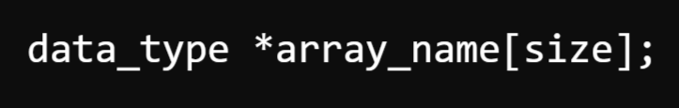
Array of pointers: ( Double Pointer)
An array of pointers is a collection of memory addresses where each pointer in the array stores the address of a variable or another data structure.
1. Declaration and Initialization:
An array of pointers can be declared like this:
data_type * → Indicates that each element in the array is a pointer.
size → Number of pointers stored.

Slide 59
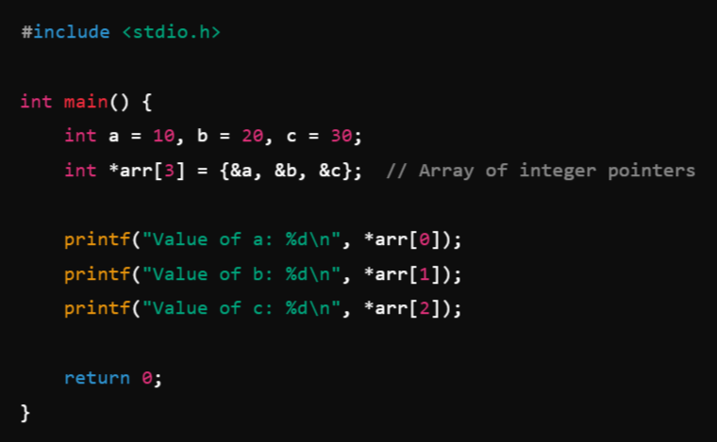
Example:
Integer Pointer Array:
Here,
arr[0] stores the address of a, so *arr[0] gives 10.
arr[1] stores the address of b, so *arr[1] gives 20.
arr[2] stores the address of c, so *arr[2] gives 30.
When we say arr[i] it gives the element present In ith index, here the element is basically pointer so to get the value we should use *arr[i]

Slide 60
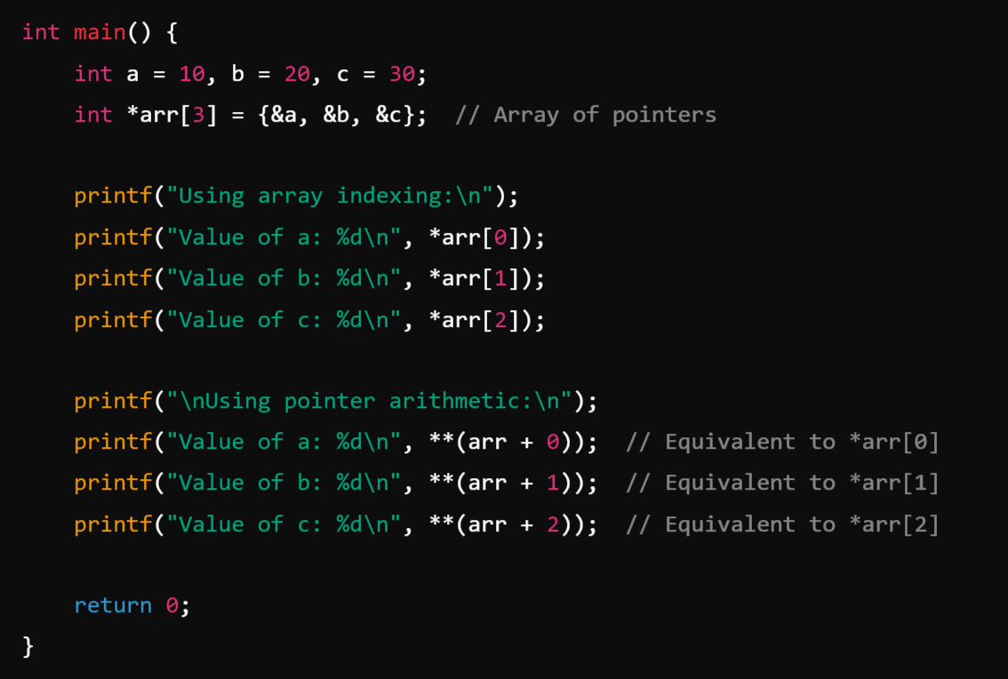
Pointer Arithmetic in an Array of Pointers:

Slide 61
Pointer Arithmetic: Double Pointer
arr is an array, so arr + 1 moves to arr[1], arr + 2 moves to arr[2], etc.
*(arr + i) gives the value at arr[i] (which is an address).
**(arr + i) gives the actual integer value.

Slide 62
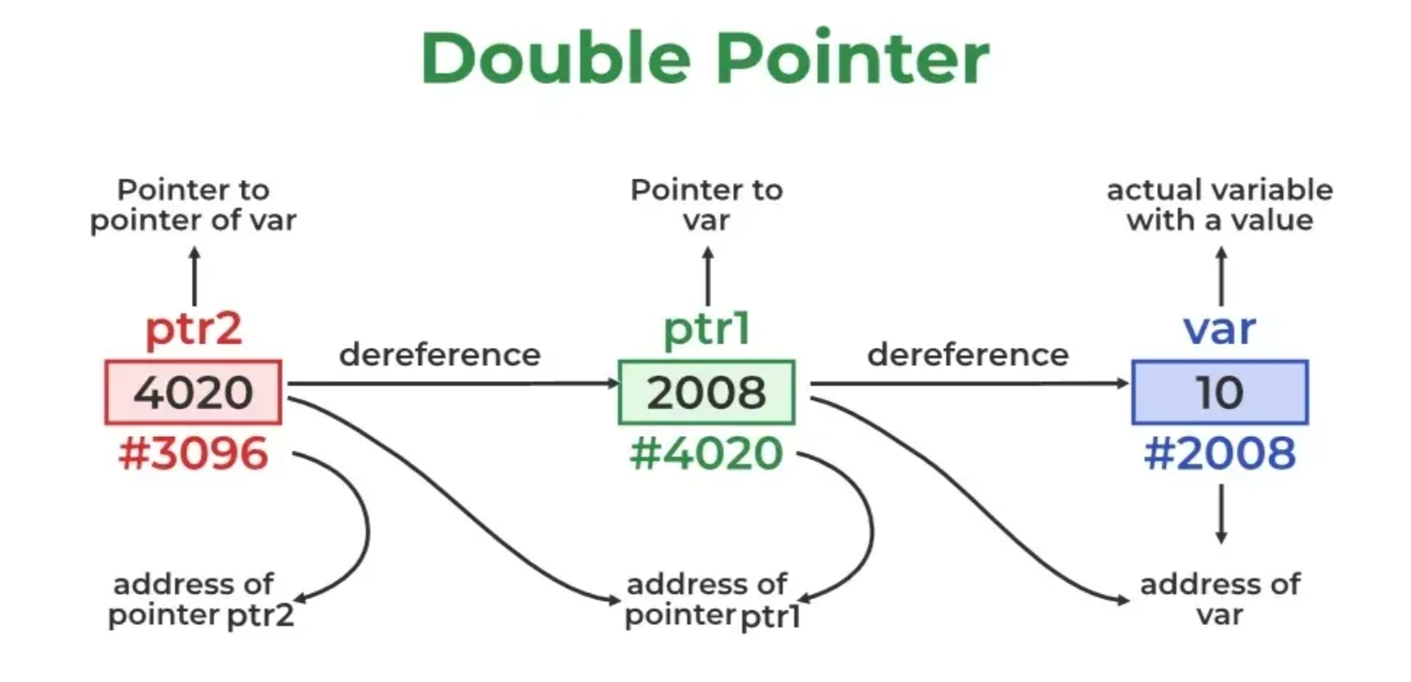

Slide 63
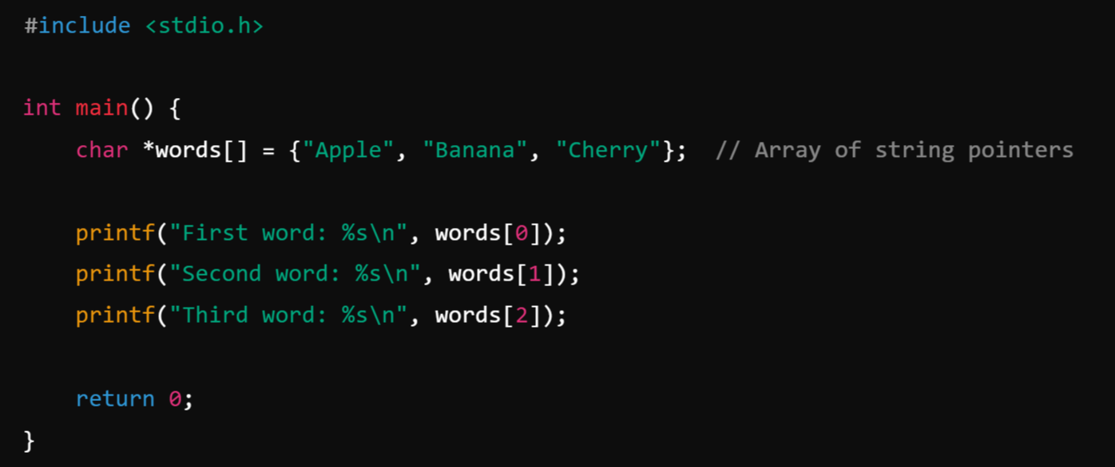
2. Array of Pointers to Strings (Character Arrays):
A common use case for an array of pointers is storing multiple strings.
Example: Array of Strings Using Pointers:

Slide 64
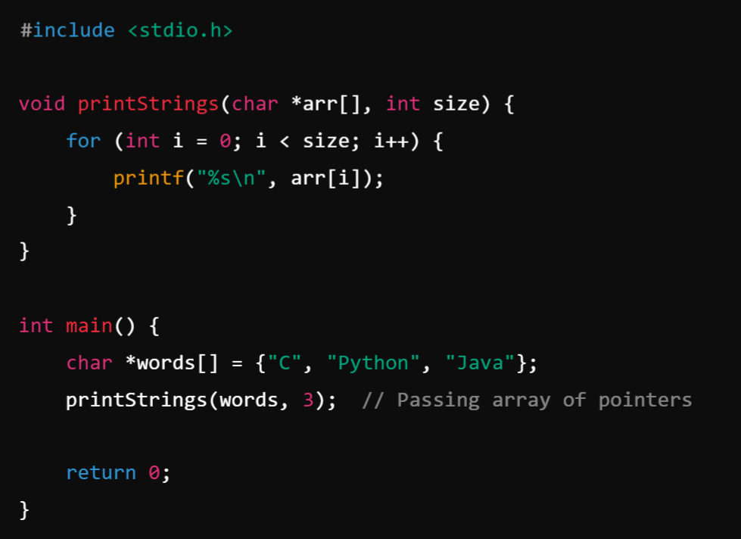
Array of Pointers in Functions: Passing an Array of Strings to a Function

Slide 65
Parameter Passing to a Function:
Pass by value
Pass by reference

Slide 66
1. Call by Value (Pass by Value):
In call by value, a copy of the actual parameter is passed to the function. Any modification inside the function does not affect the original value.

Slide 67
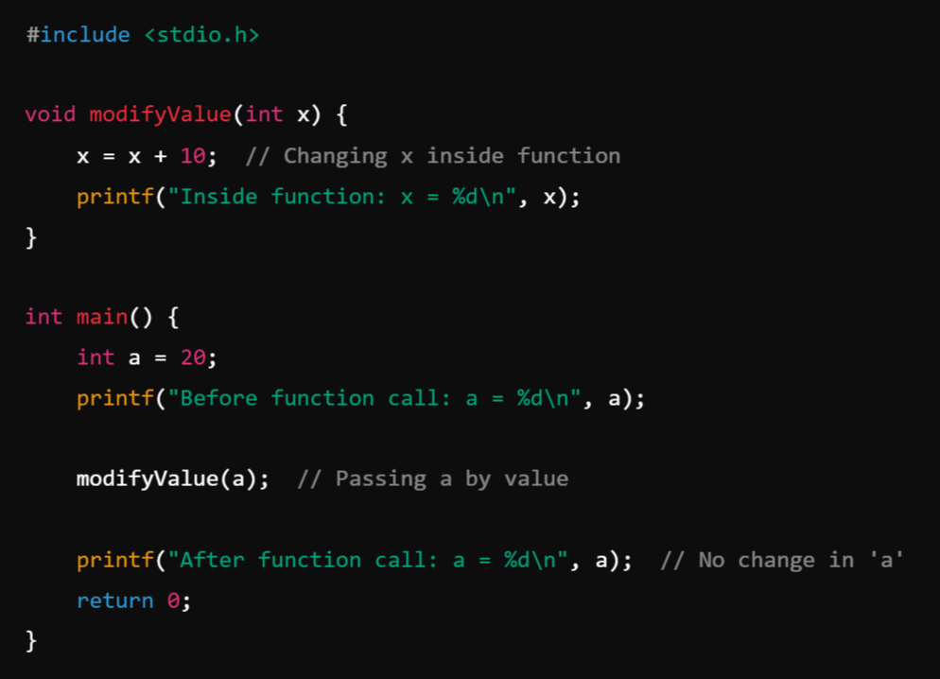
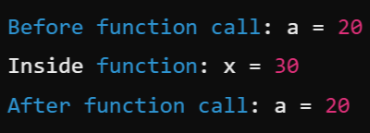
Example:
Output:

Slide 68
Explanation:
A copy of a is passed to modifyValue(), so x (parameter) gets modified inside the function.
However, a in main() remains unchanged.

Slide 69
2. Call by Reference (Pass by Reference):
In call by reference, the actual parameter's address is passed to the function. Any modification inside the function affects the original value.

Slide 70
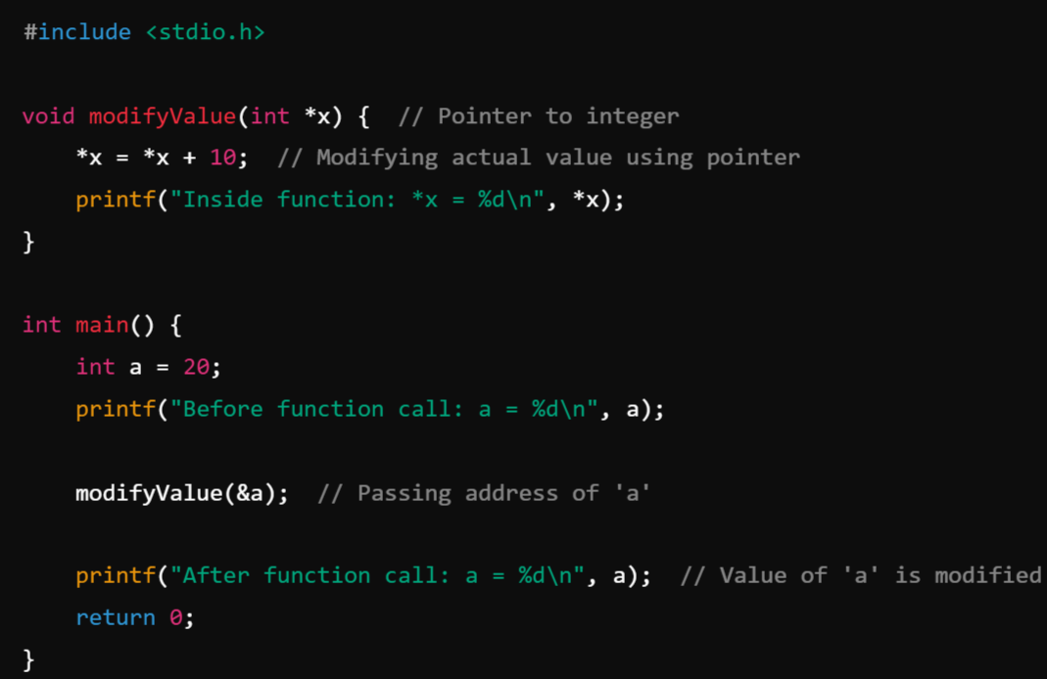
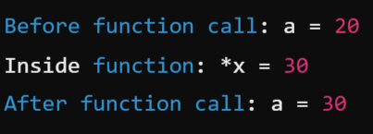
Example:
Output:

Slide 71
Explanation:
Instead of passing a copy, we pass the address of a (&a).
The function modifies the actual value stored at that address.

Slide 72
Key Difference:
Feature | Call by Value | Call by Reference
Parameter Passed | Copy of actual value | Address of actual variable
Effect on Original Variable | No change | Changes reflect in original variable
Memory Usage | More (creates a copy) | Less (uses the same variable)
Used for | Small data types | Large data structures (arrays, structures)

Slide 73
Conclusion:
Use call by value when you don’t want the function to modify the original data.
Use call by reference when you need to modify the original value or avoid copying large data structures.

Slide 74
Built-in Functions
(string and math Functions):

Slide 75
String operations with Built-in Functions:
In C, string operations include creating, manipulating, and analyzing strings. The string.h header file provides a variety of built-in functions for working with strings.

Slide 76
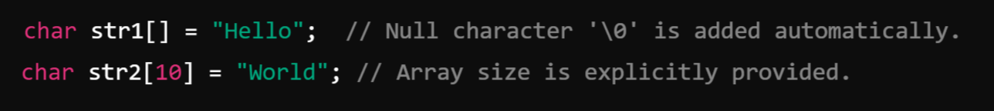
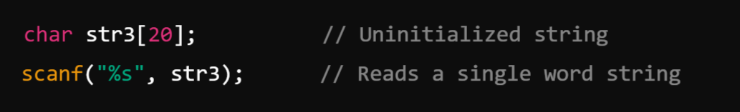
String Initialization: Strings are declared as arrays of characters and must be null-terminated.
Example:

Slide 77
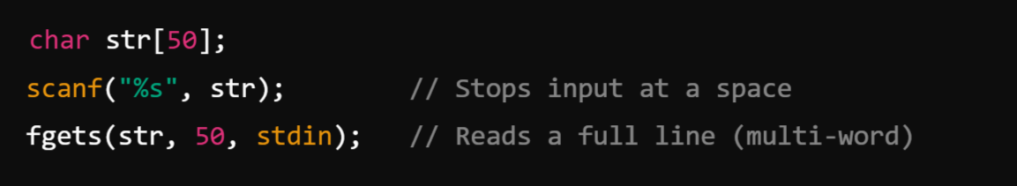

2. String Input and Output
Input:
Use scanf for single-word strings.
Use fgets for multi-word strings.
Output: Use printf to display strings.
str: A pointer to the character array where the input string will be stored.
n: The maximum number of characters to read (including the null terminator \0).
stream: The input stream to read from (e.g., stdin, a file pointer, etc.).

Slide 78


3. Finding String Length: Use strlen() to find the length of a string (excluding the null terminator).
Prototype:
Parameter: A pointer to the string (const char *str).
Return Type: The length of the string as a value of type size_t, which is an unsigned integral type.
Example:

Slide 79
4. Copying Strings: In C, copying strings involves transferring the content of one string (source) into another string (destination). Use strcpy or strncpy to copy one string into another.
strcpy does not perform bounds checking.
strncpy allows you to specify the number of characters to copy.
Using strcpy():
The strcpy function copies the entire source string (including the null terminator \0) into the destination string.
Prototype:
Destination: Must be large enough to hold the source string, including the null terminator.
Source: The string to be copied.
Return Value: A pointer to the destination string.

Slide 80

Example:

Slide 81
Using strncpy():
The strncpy function allows you to specify the number of characters to copy. This is safer and prevents buffer overflow if the source string is larger than the destination buffer.
Prototype:
num: Maximum number of characters to copy.
Null Termination: If the source string length is less than num, the destination string is padded with null characters (\0).
If the source is longer than num, the destination will not be null-terminated, so you may need to handle this manually.

Slide 82

Example:

Slide 83
5. Concatenating Strings: String concatenation in C involves joining two strings into one by appending the characters of one string (source) to the end of another (destination). Use strcat or strncat to concatenate two strings.
strcat appends the second string to the first.
strncat allows you to specify the number of characters to append.
Using strcat():
The strcat function concatenates the source string to the destination string, starting at the null terminator (\0) of the destination.
Prototype:
Destination: Must be large enough to hold the resulting string, including the null terminator.
Source: The string to be appended.
Return Value: A pointer to the destination string.

Slide 84

Example:

Slide 85
Using strncat():
The strncat function is a safer version of strcat. It allows you to specify the maximum number of characters to append.
Prototype:
num: Specifies the maximum number of characters to append from the source string.
Appends at most num characters and ensures the resulting string is null-terminated.
Useful when the size of the destination buffer is limited.

Slide 86
6. Comparing Strings:
In C, comparing strings is done to determine their equality, lexical order, or differences. Strings are compared character by character, and C provides built-in functions in the string.h library for these operations.
Use following functions to compare two strings:
strcmp() compares strings lexicographically (Alphabetically).
strncmp() compares only the first n characters.
strcasecmp() performs a case-insensitive comparison.

Slide 87

String Comparison Using strcmp():
The strcmp function compares two strings lexicographically (dictionary order).
Prototype:
Return Values:
Returns 0 if the strings are equal.
Returns a negative value if str1 is less than str2.
Returns a positive value if str1 is greater than str2.
Comparison is case-sensitive.

Slide 88

Example:

Slide 89
String Comparison Using strncmp():
The strncmp function compares up to the first n characters of two strings.
Prototype:
Limits the comparison to at most n characters.
Useful for partial string comparisons or ensuring bounds safety.
Like strcmp, it is case-sensitive.

Slide 90

Example:

Slide 91

Case-Insensitive Comparison:
The standard C library does not include a built-in case-insensitive string comparison function, but some compilers provide strcasecmp and strncasecmp for this purpose.
Prototype (Non-Standard):

Slide 92

Example:

Slide 93
Most Commonly Used Math Built-in Functions in C (math.h)
C provides a set of mathematical functions in the <math.h> library to perform arithmetic, trigonometric, logarithmic, and other operations.
Basic Arithmetic Functions:
Function | Description | Example
fabs(x) | Returns the absolute value of x (floating-point). | fabs(-3.5) → 3.5
ceil(x) | Rounds x up to the nearest integer. | ceil(2.3) → 3.0
floor(x) | Rounds x down to the nearest integer. | floor(2.7) → 2.0
round(x) | Rounds x to the nearest integer. | round(2.5) → 3.0
trunc(x) | Removes the fractional part of x (truncates). | trunc(2.9) → 2.0

Slide 94
2. Power and Exponential Functions:
Function | Description | Example
pow(x, y) | Computes x^y (x raised to power y). | pow(2, 3) → 8.0
sqrt(x) | Computes square root of x. | sqrt(16) → 4.0
cbrt(x) | Computes cube root of x. | cbrt(27) → 3.0
exp(x) | Computes e^x (exponential function). | exp(1) → 2.718
log(x) | Computes natural logarithm (ln x). | log(2.718) → 1.0
log10(x) | Computes base-10 logarithm (log₁₀ x). | log10(100) → 2.0

Slide 95
3. Trigonometric Functions:
Function | Description | Example
sin(x) | Computes sine of x (in radians). | sin(3.14) → ~0.0
cos(x) | Computes cosine of x (in radians). | cos(0) → 1.0
tan(x) | Computes tangent of x (in radians). | tan(0) → 0.0
asin(x) | Computes arcsine (sin⁻¹(x)) in radians. | asin(0.5) → ~0.52
acos(x) | Computes arccosine (cos⁻¹(x)) in radians. | acos(0.5) → ~1.05
atan(x) | Computes arctangent (tan⁻¹(x)) in radians. | atan(1) → ~0.78
atan2(y, x) | Computes tan⁻¹(y/x), returns angle in radians. | atan2(1, 1) → ~0.78

Slide 96
4. Hyperbolic Functions:
5. Remainder and Modulus Functions:
Function | Description | Example
sinh(x) | Computes hyperbolic sine of x. | sinh(0) → 0.0
cosh(x) | Computes hyperbolic cosine of x. | cosh(0) → 1.0
tanh(x) | Computes hyperbolic tangent of x. | tanh(0) → 0.0
Function | Description | Example
fmod(x, y) | Computes remainder of x/y as a floating-point value. | fmod(10.5, 3) → 1.5
remainder(x, y) | Returns the remainder of x/y, but rounds towards even values. | remainder(10.5, 3) → -1.5

Slide 97


Basic Math Functions:
(a) fabs(x) – Absolute Value
Syntax:
Example:

Slide 98


2. ceil(x) – Round Up
Syntax
Example:

Slide 99


3. floor(x) – Round Down
Syntax
Example:

Slide 100


4. round(x) – Round to Nearest Integer
Syntax
Example:

Slide 101


4. trunc(x) – Truncate Decimal Part
Syntax
Example:

Slide 102


2. Power and Root Functions:
1. pow(x, y) – Power (x^y):
Syntax:
Example:

Slide 103


2. sqrt(x) – Square Root
Syntax
Example:

Slide 104


2. cbrt(x) – Cube Root
Syntax:
Example:

Slide 105


2. exp(x) – Exponential (e^x)
Syntax:
Example:

Slide 106


2. log(x) – Natural Logarithm (ln x)
Syntax:
Example:

